Slide 1
Notes:
Greetings and welcome to our virtual training platform. Today we will focus on respiratory safety. Let’s get started.

Slide 2
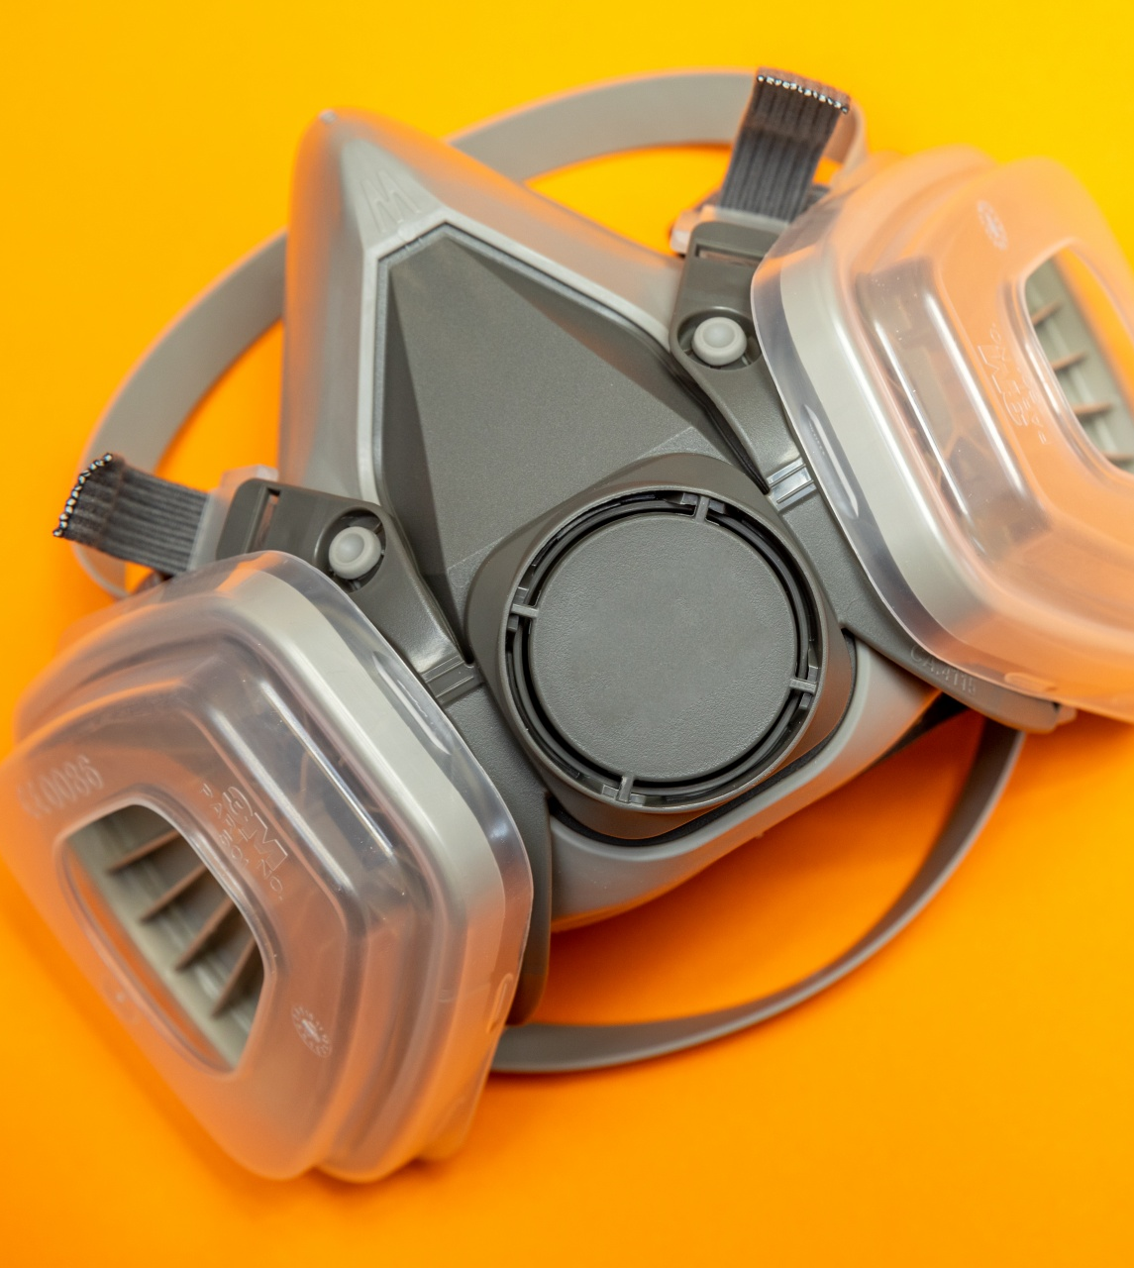
respiratory safety
Notes:
Respiratory safety is incredibly important in the workplace. Today we will go over respiratory purpose, hazards, and how to maintain a respirator.

Slide 3
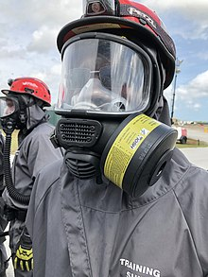
Respirator Purpose
A respirator protects the user from harmful inhalation of toxic atmosphere hazards such as:
Dusts, fogs, fumes, mists, gases, smokes, sprays, fibers or vapors
The primary objective shall be to prevent contamination from toxic vapors
This Photo by Unknown Author is licensed under CC BY-SA
Notes:
A respirator is a device to protect the wearer from the inhalation of harmful atmospheres. Respirators must be approved for the type and severity of conditions in which they are to be used

Slide 4
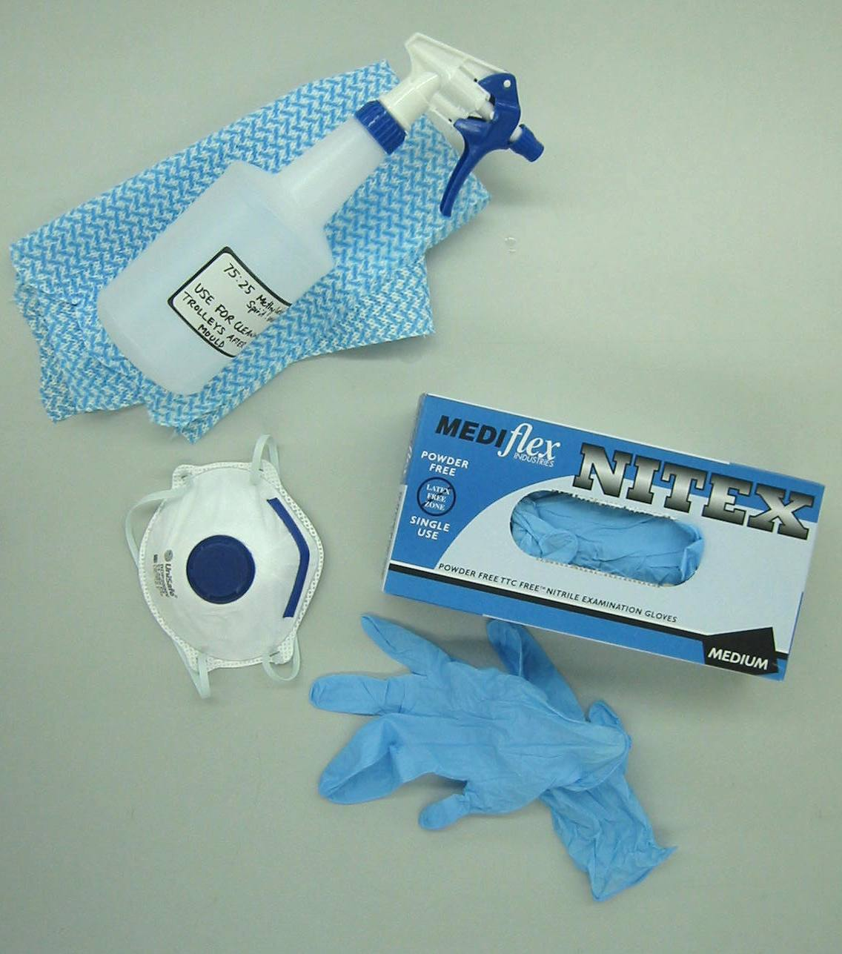
Required Maintenance
Respirators should be clean and disinfected as often as necessary if used by one employee.
After each use if used by more than one employee
Stored and protected from damage, dust, sunlight
Inspected before use and if found defective do not use and notify supervisor
This Photo by Unknown Author is licensed under CC BY-SA-NC
Notes:
Employer should provide cleaning and disinfecting material for respirators and Inspected before use.
Inspections should include Checking for proper function and Checking all rubber parts for deterioration.

Slide 5
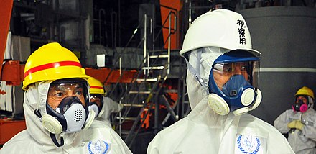
Major types of respirators
Two Types:
Air Purifying
Atmosphere supplying respirators
Must be approved by NIOSH
Medical evaluation required
This Photo by Unknown Author is licensed under CC BY-SA
Notes:
NIOSH : The National institute of Occupational Safety and Health must approve all respirators.
Atmosphere supplying: or Air supply is received from compressed air, oxygen tank or compressor driven air not from the atmosphere.

Slide 6
Notes:
I hope that you have found the information presented today to be useful. We welcome the opportunity to further assist you with developing your safety policies and procedures. If you have any further questions, you may contact us at CompSource Mutual at the numbers provided on the screen. Have a great day!

