Slide 1
Notes:
Greetings and welcome to our virtual training platform. Today we will focus on power hand tools. Let’s get started.

Slide 2
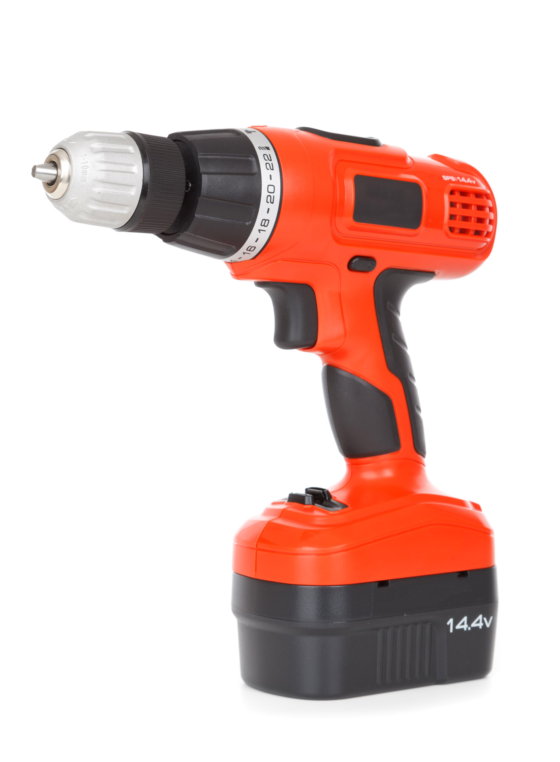
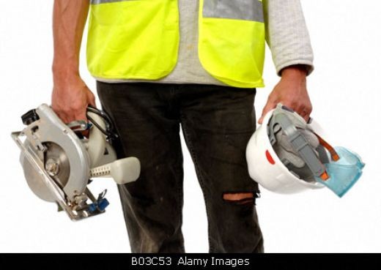
Power hand tools
Notes:
We will be discussing hazards associate with power hand tools, common injuries with power hand tools, and how to prevent hazards in your workplace.

Slide 3
Power Tool Precautions
Disconnect tools when not in use, before servicing and cleaning, and when changing accessories
Keep people not involved with the work away from the work
Secure work with clamps or a vise, freeing both hands to operate the tool
Don’t hold the switch button while carrying a plugged-in tool
Keep tools sharp and clean
Remove damaged electric tools & tag them: “Do Not Use”
This Photo by Unknown Author is licensed under CC BY-SA-NC
Notes:
Some power tool precautions include:
Disconnect tools when not in use, before servicing and cleaning, and when changing accessories
Keep people not involved with the work away from the work
Secure work with clamps or a vise, freeing both hands to operate the tool
Don’t hold the switch button while carrying a plugged-in tool
Keep tools sharp and clean
Remove damaged electric tools & tag them: “Do Not Use”

Slide 4
Hazards Associated with Power Tools
Workers using hand and power tools may be exposed to these hazards:
Objects that fall, fly, are abrasive, or splash
Harmful dusts, fumes, mists, vapors, and gases
Frayed or damaged electrical cords, hazardous connections and improper grounding
Vibration and impact
Notes:
Hand and power tools are a part of our everyday lives. These tools help us to perform tasks that otherwise would be difficult or impossible. However, even simple tools can be hazardous, and have the potential for causing severe injuries when used or maintained improperly. Special attention toward hand and power tool safety is necessary in order to reduce or eliminate these hazards.

Slide 5
Basic Tool Safety
Maintain regularly
Inspect before use
Use the right tool for the job
Operate according to manufacturers’ instructions
Use the right Personal Protective Equipment (PPE)
Use guarding
Notes:
Basic tool safety includes maintain tools regularly, inspecting tools before starting your task, always using the correct tool for a specific job, proper PPE should be on before handling power tools, and if specific equipment has guards make sure they are in the proper position before starting your task.

Slide 6
Power Tool Personal Protective Equipment
Keep floor surface where working free from debris and tripping or slipping hazards
Keep cutting tools sharp
Use tools as they were intended to be used
Use Personal Protective Equipment (PPE), such as safety glasses and gloves
PPE determined by Job Hazard Analysis (JHA)
Notes:
Employees should be given the proper PPE when using hand and power tools to protect them from hazards of falling, flying, abrasive, and splashing objects, or exposure to harmful dusts, fumes, mists, vapors, or gases.

