Slide 1
Slips, trips and fall prevention Safety and risk control department
Notes:
Greetings and welcome to our virtual training session on slips, trips, and fall prevention. We will cover definitions, categories of slips, trips, and falls, as common injuries, and prevention strategies. Let’s get started!

Slide 2
Slips, trips and falls make up the majority of general industry accidents, which account for:
15% of all accidental deaths per year, which is the second-leading cause behind motor vehicles according to the U.S. Department of Labor
Notes:
Slips, trips and falls make up the majority of general industry accidents, which account for:
15% of all accidental deaths per year, this is the second-leading cause behind motor vehicles according to the U.S. Department of Labor
They also account for about 25% of all reported injury claims per fiscal year and;
More than 95 million lost work days per year which is about 65% of all work days lost

Slide 3
Definitions:
Slips: The loss of balance caused by too little friction or traction between your feet (footwear) and the walking or working surface.
Trips: A loss of balance caused from a person’s foot contacting an object or dropping to a lower level while moving forward or backwards.
Falls: The result of a trip or slip that causes the body to loose balance and strike a surface or object.
Notes:
Before we dive in, let’s consider some definitions to help understand today’s topic:
First we have Slips, which are the loss of balance caused by too little friction or traction between your feet and the walking or working surface.
Next are Trips, which are a loss of balance caused from a person’s foot contacting an object or dropping to a lower level while moving forward or backwards. And lastly, there are;
Falls, which are the result of a trip or slip that causes the body to loose balance and strike a surface or object.

Slide 4
Slips are categorized as:
Forward motion slips
Backward motion slips
Slips may be caused by:
Wet, oily or slippery surfaces
Occasional spills
Weather hazards
Loose, unanchored rugs or mats
Flooring or other worn walking surfaces
This Photo by Unknown Author is licensed under CC BY
Notes:
As you know, there are many reasons slips occur. Forward motion and backward motion are the two main categories and causes can range from;
Wet, oily or slippery surfaces such as water being tracked in by rain or oil and even some cleaners can cause a very slippery surface
Occasional spills that haven’t been cleaned up or marked with a wet floor sign
Weather hazards such as snow and ice
Loose, unanchored rugs or mats and
Flooring or other worn walking surfaces

Slide 5
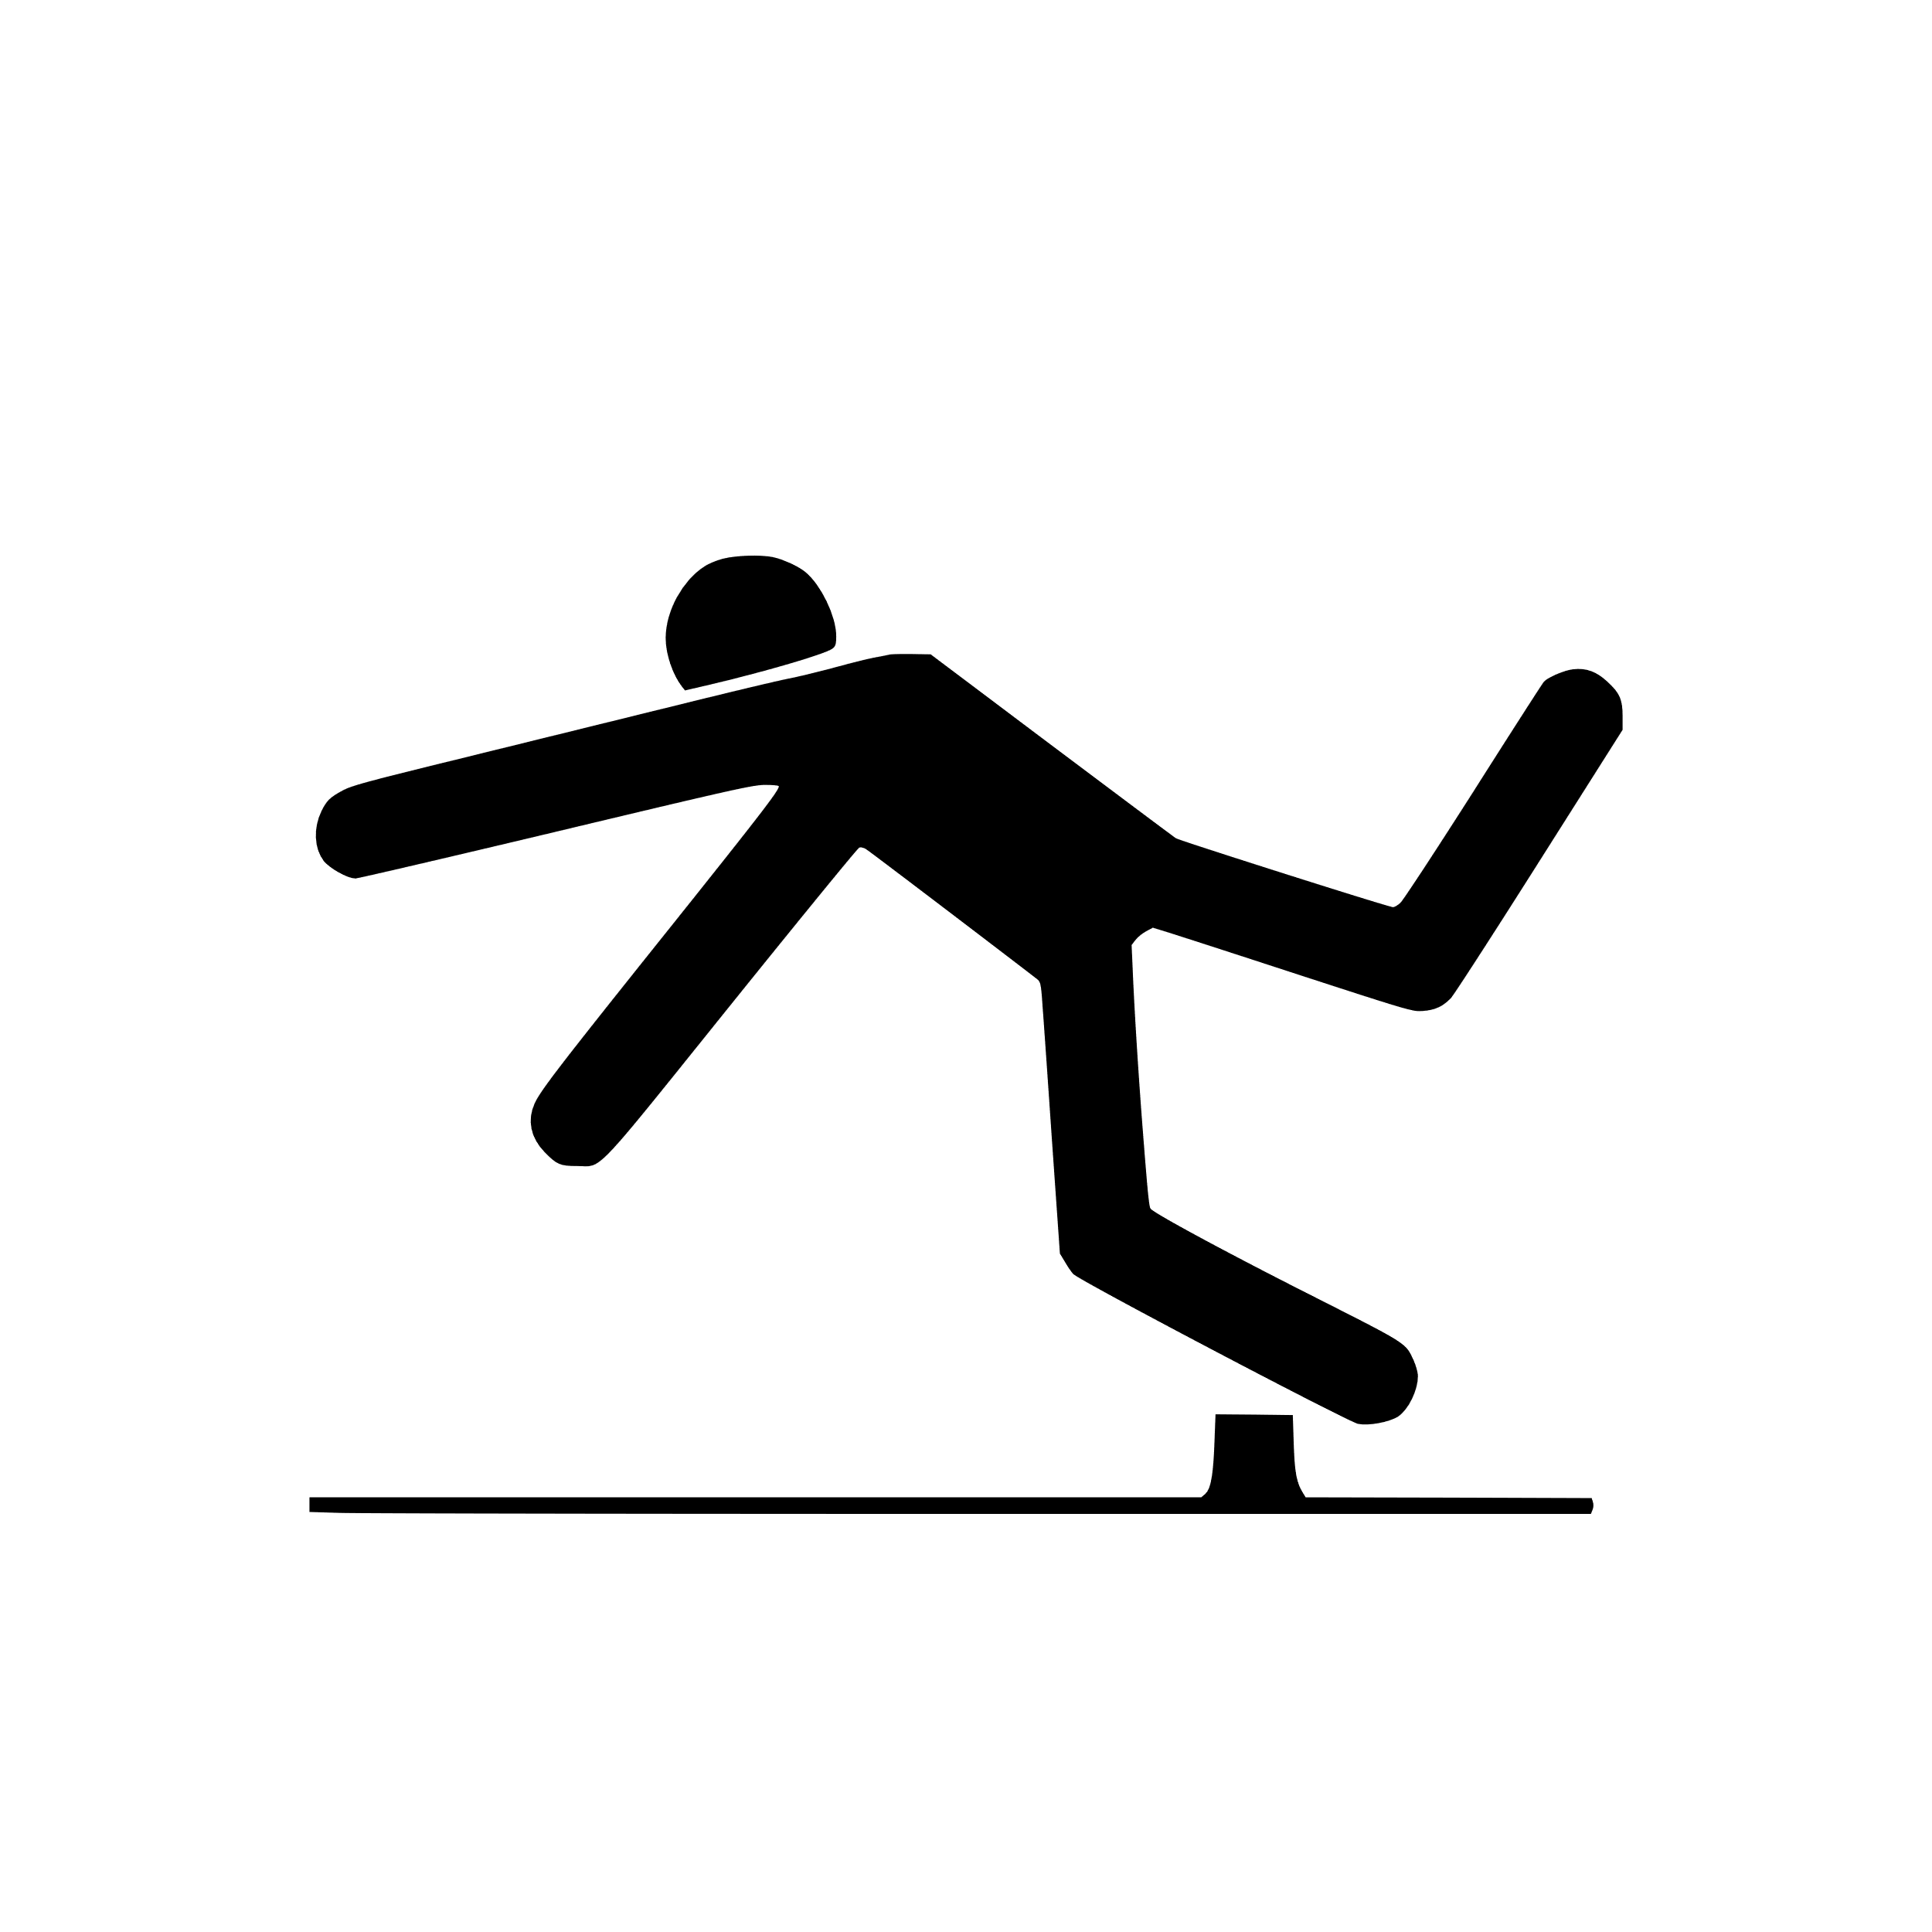
Trips are categorized as:
Toe stub
Differing step height
Drop step
Obstructed path
Trips may be caused by:
Obstructed view
Poor lighting
Cluttered areas
Uncovered cables
Unclosed drawers
Wrinkled carpeting or lifted floor mats
Uneven walking surfaces (steps, thresholds)
Notes:
Next, we have trips which we can categorize into four main areas including
Toe stubs where your foot strikes an object such as furniture or a door jamb
Differing step heights when the step is higher than expected
A drop step which is when a step height is lower than expected or not marked properly and;
An obstructed pathway such as running into something due to bad housekeeping.
Some common hazards to look out for in relation to trips are listed here. Think about each of these in relation to your work area…
Obstructed view
Poor lighting
Cluttered areas
Uncovered cables
Unclosed drawers
Wrinkled carpeting or lifted floor mats as well as
Uneven walking surfaces such as (steps or thresholds)
Don’t wait to make corrections to these areas. Acting promptly may save you or a co-worker from serious injury.

Slide 6
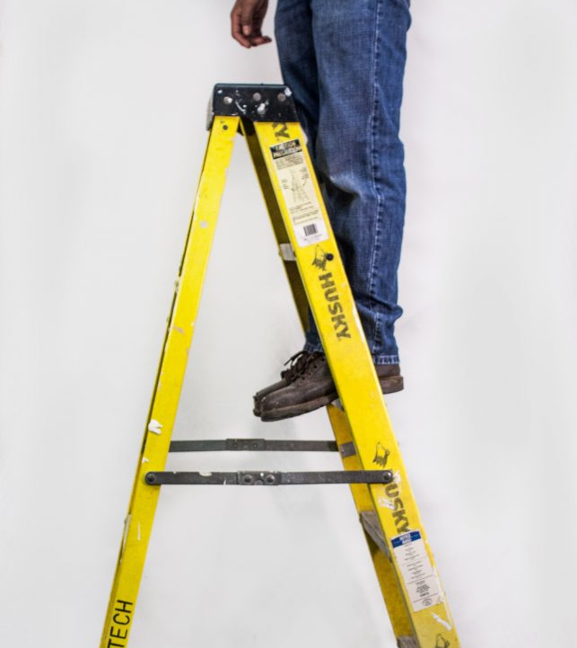
Falls are categorized as:
Type 1: Same level falls
Slip or trip immediately precedes fall to the floor or walkway
Type 2: Elevated falls to a lower level.
Falls are from a platform, dock, ladder, step or stair
This Photo by Unknown Author is licensed under CC BY-SA-NC
Notes:
Last, we have falls. Falls can occur on level ground as well as from an elevated surface such as a ladder or ledge.
Used improperly ladders and stepstools can add to a fall hazard such as leaning to far from it and losing balance or stepping on the top step to work. However, when used correctly these tools can play a vital step in your safety for reaching heights. Never substitute these for a chair, table or any other item that is unsafe to gain height.

Slide 7
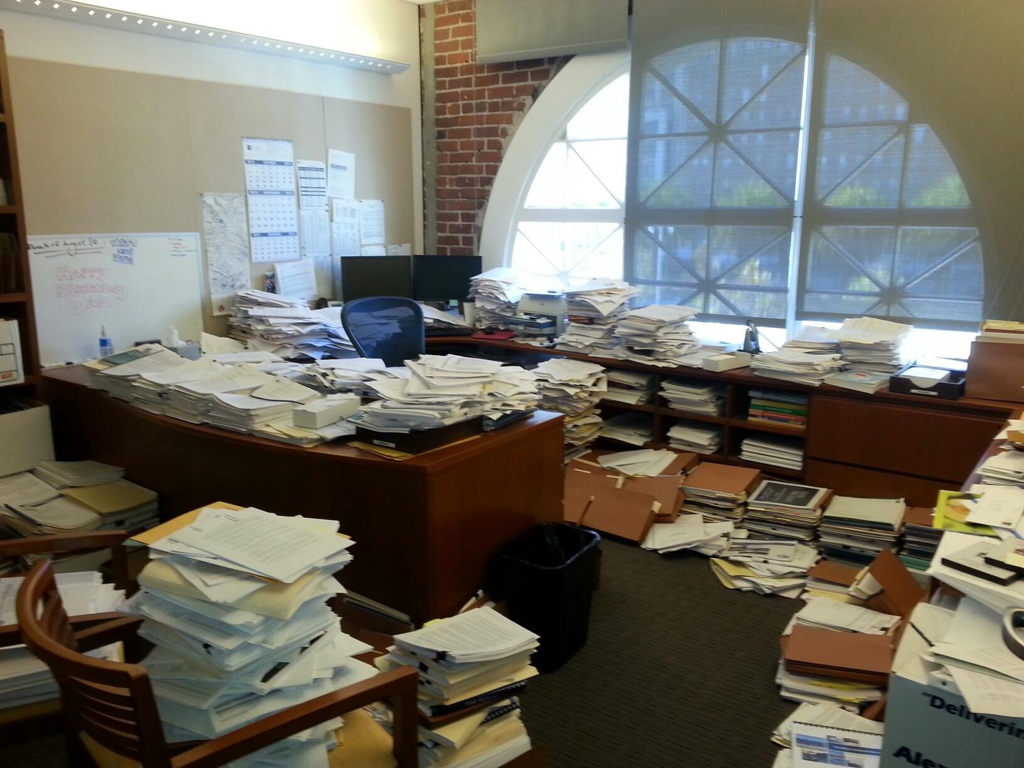
Other contributing factors:
Impaired senses (sight, hearing or feeling)
Fatigue or illness
Being in a hurry and/or rushing around
Medications, alcohol or drugs
Behaviours/emotions
Poor housekeeping (clutter)
Improper or no signage
Not holding onto handrails
Lifting/carrying too much
This Photo by Unknown Author is licensed under CC BY-NC
This Photo by Unknown Author is licensed under CC BY-ND
Notes:
No one goes to work thinking they may have a slip trip or fall injury however there are contributing factors that we can look for and work to eliminate to lessen those odds such as;
Going about your day with impaired senses due to
Fatigue or illness
Being in a rush or a hurry
Dealing with negative effects of medications or other substances
Letting emotions take over leading to unsafe actions such as being angry, sleepy, excited or stressed
Having poor housekeeping which can then enhance the negative effects of being in a hurry
Not having proper signage such as for wet or uneven floors
Not using handrails where available as well as
Trying to carry too large or heavy of a load
Taking care of yourself and your space can reduce the chance of a workplace accident. It’s imperative to pay attention to the warning signs.

Slide 8
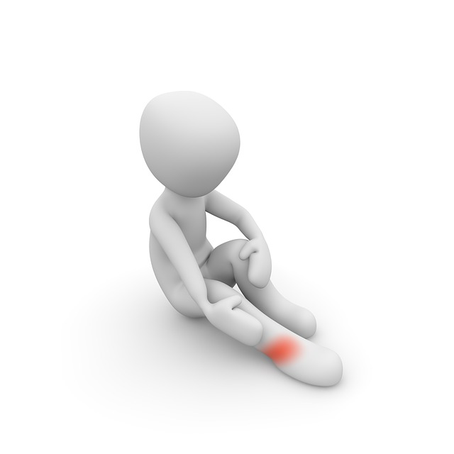
Common injuries associated with slips, trips and falls:
Sprain and strains
Bruises and contusions
Abrasions and lacerations
Fractures
Remember, the primary cause of any accident can be attributed to a lack of attention!
Notes:
Common injuries that we see associated with slips, trips and falls are
Sprains and strains which are injuries to ligaments, muscles, and tendons
Bruises and contusions which are injuries to the body with visible bleeding under the skin
Abrasions and lacerations which range from scraping to puncturing the skin
As well as bone fractures.
Most accidents can be attributed to the lack of attention to your surroundings.

Slide 9
Prevention strategies
Although there is never any way to completely prevent accidents or injuries, there are ways to reduce the likelihood of them happening.
Promote injury awareness
Education of supervisors, risk managers, employees
Gather information about injuries
Determine how to reduce injuries
Implement & train prevention strategies
Follow up to determine effectiveness
This Photo by Unknown Author is licensed under CC BY-SA-NC
Notes:
Although there is never any way to completely prevent accidents or injuries, there are ways to reduce the likelihood of them happening such as;
Promoting injury awareness by holding (in-service training, presentations, using inspection checklists for your workplace, and hanging posters, or signage
Educating all employees on desired safe work practices
Gathering information about injuries such as type, location, and what equipment if any was being used
Coming up with ways to reduce injuries such as taking into account those areas with high potential for injury to be corrected
And finally re-addressing solutions to make sure they are effective and stay that way

Slide 10
Things to consider:
Selection of proper footwear
Consider time outdoors
Discuss proper fit, comfort, fatigue, and safety
Good housekeeping
Keep floors clean
Use proper signage
Remove obstacles from walkways
Use portable lighting when needed
Be extra alert when carrying or pushing objects
Secure rugs and carpets
Notes:
Additional things to consider are the selection of proper footwear.
Shoes should be flat, close toed and have an anti slip sole. Additionally, consider your time outdoors and inclement weather. Leave your house prepared for the conditions.
Housekeeping is another major area to focus on.
Floors should be kept clear and spills cleaned immediately. Don’t leave this task for the next person. It may be too late.
Ensure proper wet floor signs are used until floors are dry.
Remove obstacles from walkways such as ensuring cables are covered, closing cabinets drawers, and replacing burnt out bulbs)
Use portable lighting when needed
Be alert when carrying or pushing objects. Walk your path without the load to check for obstacles first.
And secure any rugs or carpet that are flipped up on the edges.

Slide 11
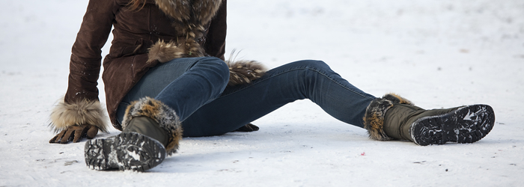
Inclement weather
Be prepared!
Slow down to react to traction changes
Wear slip resistant shoes or overshoes (carry your work shoes)
Wear sunglasses outdoors (sunny, snow or icy days)
Be careful of wet shoes on dry floors
This Photo by Unknown Author is licensed under CC BY-SA
Notes:
Inclement weather can create slick surfaces and increase workplace accidents. There are steps we can take to be ready…
Take it slow. Traction changes can more likely be corrected when moving slowly.
Slip resistant shoes or overshoes should be used. If needed you can carry work shoes in and change once inside.
Sunglasses help minimize glare on sunny and snowy days
Additionally, take time to dry your shoes completely. Depending on the floor type a wet shoe and dry surface can make a very slick walking surface.

Slide 12
Reporting hazards
Report all hazards immediately
Reduce risk of hazards
Alert all persons in the area
Mark off the area and stay there until the issue is corrected
Remove the hazards whenever possible
In the event of an emergency, CALL 911!
This Photo by Unknown Author is licensed under CC BY-SA
Notes:
Lastly, lets discuss reporting hazards.
The most important tip to remember is to report the hazard immediately. Don’t wait for someone else to and don’t leave the area.
Alert anyone in the area and mark off access if possible until the issue is resolved
If you can; work to correct the hazard right away and in the event of an emergency call 911.

Slide 13
Notes:
Thank you for your time today. I hope you have found today’s topic to be beneficial to your training needs. We welcome the opportunity to partner with you to help further develop your safety policies and procedures. If we can be of assistance, please contact us directly at the numbers provided on the screen. Have a great day!

