Slide 1
Scaffold safety Safety and risk control department
Notes:
Greetings and welcome to our virtual training platform. My name is X I am a risk and safety consultant at CompSource Mutual Insurance Company. Today we will be talking about scaffold safety including common hazards, how to keep workers safe while working on scaffolding, as well as safe construction tips. Let’s get started.

Slide 2
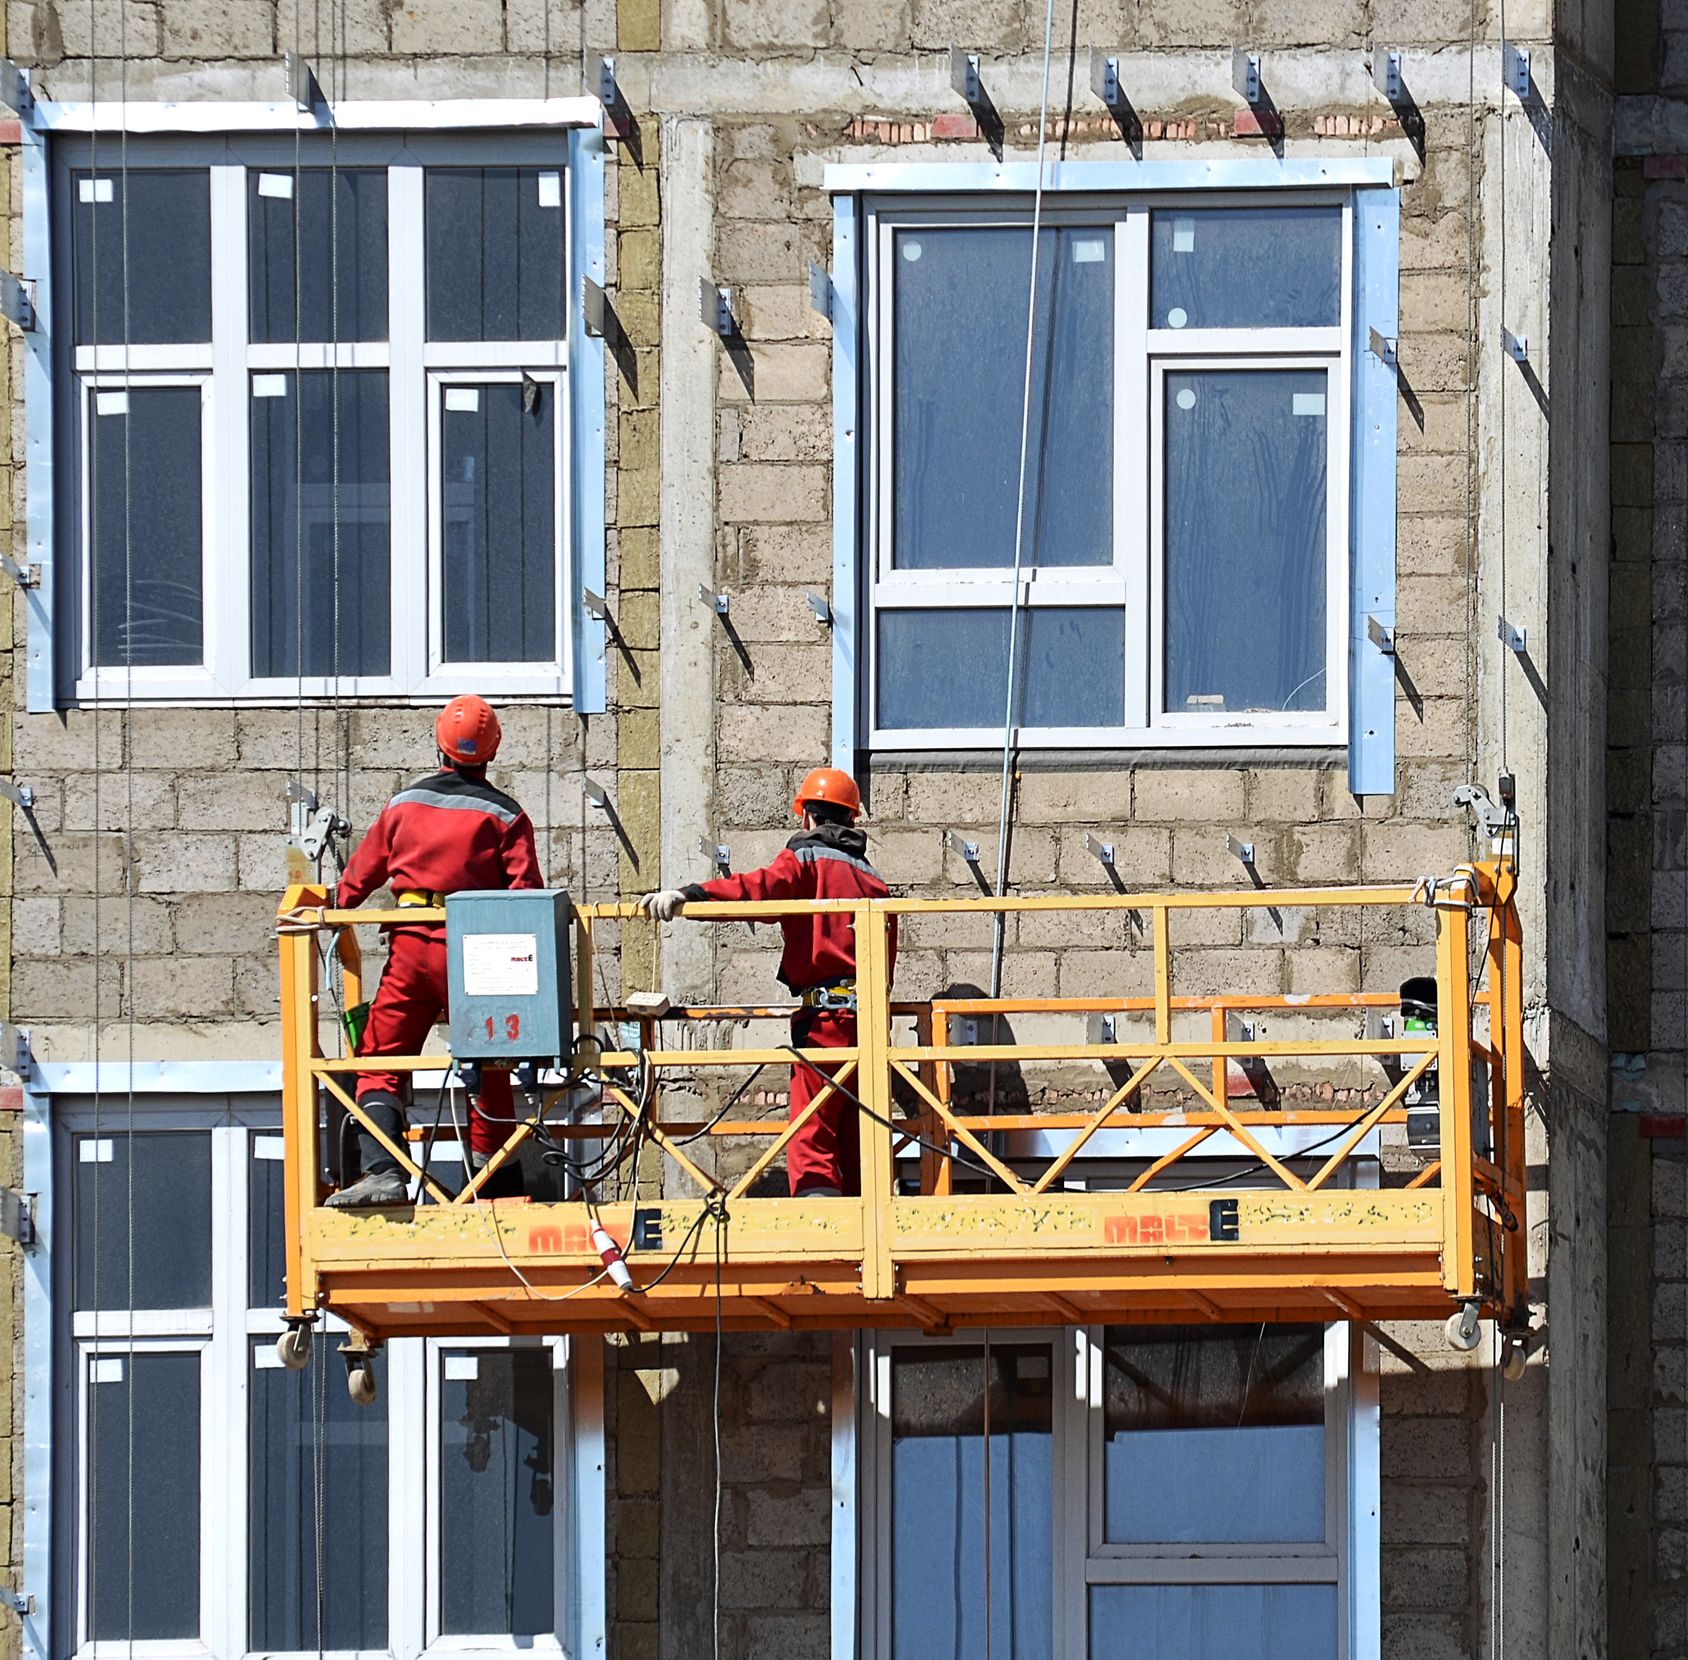
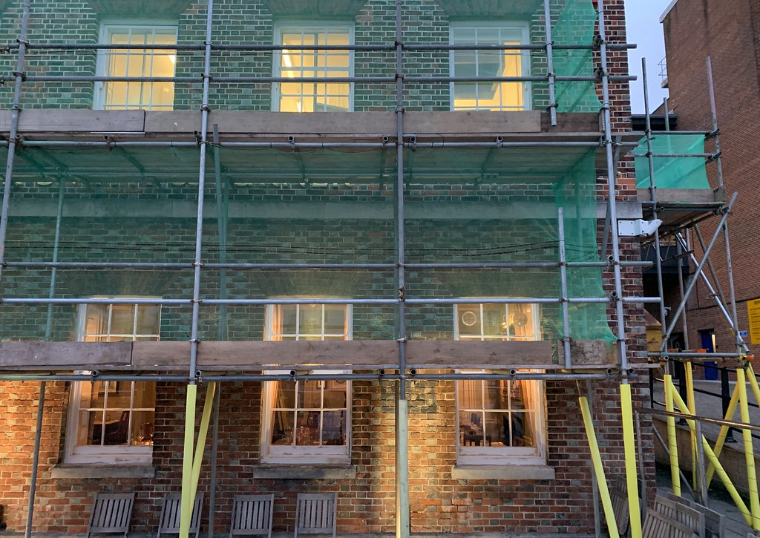
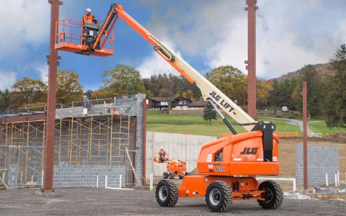
What is a scaffold?
An elevated, temporary work platform
Three basic types:
Suspended scaffolds
Supported scaffolds
Aerial Lifts
This Photo by Unknown Author is licensed under CC BY-ND
This Photo by Unknown Author is licensed under CC BY
This Photo by Unknown Author is licensed under CC BY-SA
Notes:
First, lets discuss what scaffolding is… There are various styles, but they are all forms of elevated temporary work platforms. Here are the three main types:
Supported scaffolds are platforms supported by rigid, load bearing members, such as poles, legs, frames, & outriggers.
Next, we have suspended scaffolds. These are platforms suspended by ropes or other non-rigid, overhead support.
And last are aerial Lifts which are mobile elevated work platforms used for temporary access to inaccessible areas usually due to height.

Slide 3
Hazards
Falls from elevation
Struck by
Electrocution
Scaffold collapse
Bad planking
Notes:
An estimated 2.3 million construction workers, or 65% of the construction industry, work on scaffolds frequently.
Protecting these workers from scaffold-related accidents would prevent 4,500 injuries and 50 deaths per year according to the department of labor statistics.
So what are the common hazards of working on scaffolding? As you see listed here they are;
Falls from elevation caused by slipping, unsafe access, and the lack of fall protection
Struck by Injuries caused by falling tools and/or debris
Electrocution from overhead power lines
Scaffold collapse caused by instability or overloading as well as
Bad planking giving way
Next, lets look at how to address each of these hazards.

Slide 4
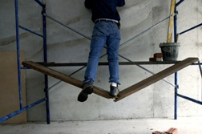
Protecting workers from falls
During climbing activity
Unguarded platforms
Platform or plank failure
This Photo by Unknown Author is licensed under CC BY-ND
Notes:
Falls can happen in several ways when working from scaffolding such as…
While climbing on or off the scaffold
While working on unguarded scaffold platforms and;
When scaffold platforms or planks fail

Slide 5
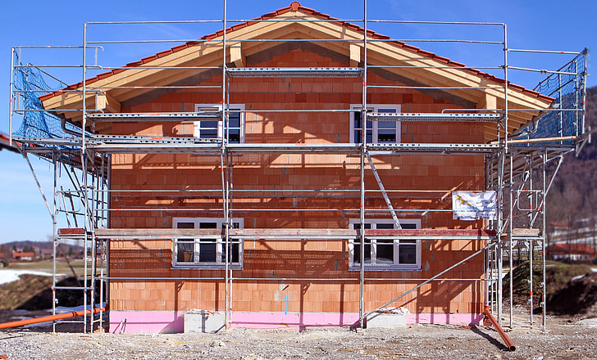
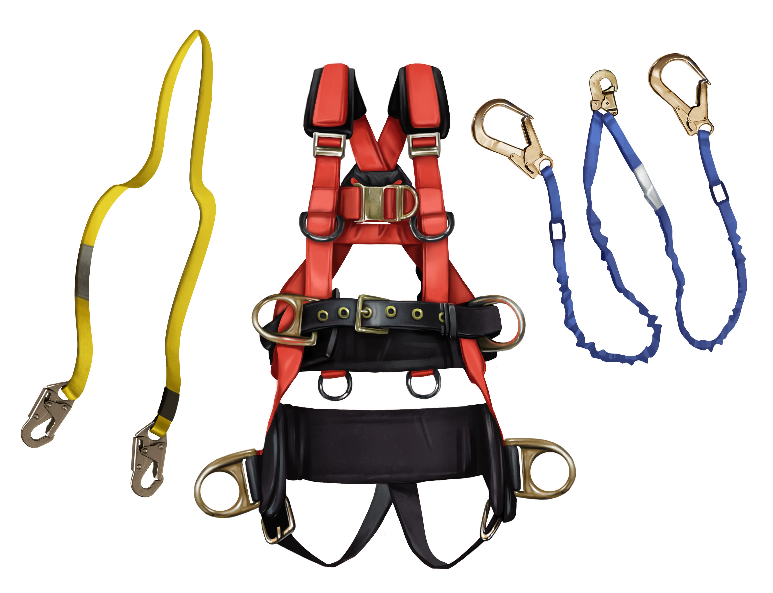
Protecting workers from falls
If a worker on a scaffold can fall more than 10 feet, protect them by:
Guardrails,
and/or
Personal Fall Arrest Systems (PFAS)
This Photo by Unknown Author is licensed under CC BY-SA
This Photo by Unknown Author is licensed under CC BY-SA
Notes:
If a worker can fall 10 feet or more, scaffold must have guardrail and toe board installed or they must have on a personal fall arrest system or PFAS
Additional screening is required when materials are stacked higher than the toe board

Slide 6
Protecting workers from falls
Guardrails
Install along open sides and ends
Front edge of platforms not more than 14 inches from the work, unless using guardrails and/or PFAS
Top rails - 38 to 45 inches tall
Mid rails- halfway between top rail and platform
Toe boards- at least 3-1/2 inches high
Notes:
When guardrails are used they should be installed along all open sides and ends.
Additionally the interior edge of the platform can be no more than 14 inches away from the work which would create another fall hazard. If it has to be more than 14 inches away added guardrails would need to be installed within certain specifications;
Top rails must fall between 38 to 45 inches in height
Toe boards must be at least 3 and ½ inches high and midrails should be placed halfway between the top rail and platform
Most companies opt for this type of passive fall protection because they are easy to install and require no interaction to work.

Slide 7
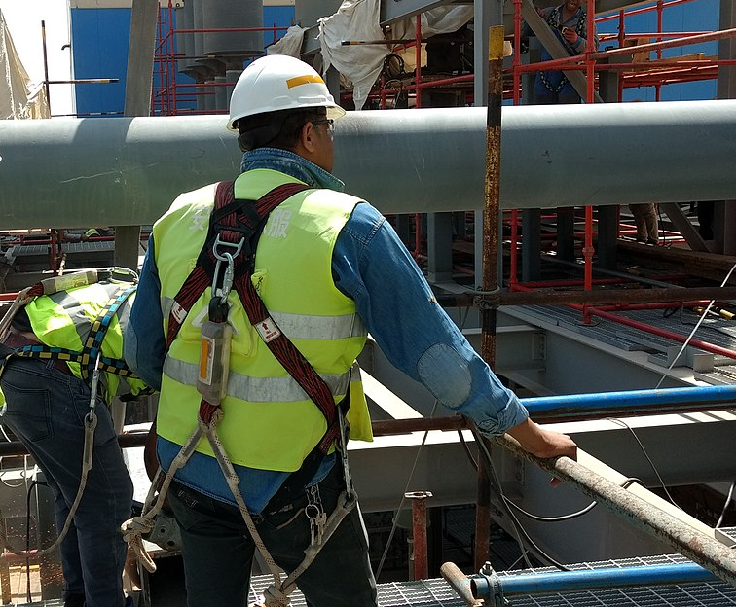
Protecting workers from falls
Personal fall arrest system
PFAS can be used instead of guardrails on some scaffolding
Guardrails and PFAS should be used on suspension scaffolding
Use PFAS on erectors and dismantlers where feasible
Training is needed on how to properly use PFAS
PFAS includes anchorage, lifeline, and body harness
This Photo by Unknown Author is licensed under CC BY-SA
Notes:
Our other fall protection option is to use a personal fall arrest system or PFAS.
When guardrails are not used there is the option of tying off to an appropriate anchor point instead.
For suspension scaffolding PFAS is required even though the platform is enclosed by railing;
And where possible PFAS should be worn during erecting and dismantling activities for scaffolding.
Separate training should be provided where PFAS is used. There are specific areas to address such as
components including anchorage lifeline and body harness, and how they work together
Inspection of the equipment
Fitting the equipment to the user
Covering design of the equipment and what needs to be used for each individual job and last
Determining a proper anchor point

Slide 8
Falling object protection
Wear your hardhats!
Barricade
Use panels or screens
Build a canopy or install a net
Anytime an overhead hazards exists, wear your head protection!
This Photo by Unknown Author is licensed under CC BY-SA-NC
Notes:
Another critical element of working at heights is having head protection.
Any time there is an overhead hazard such as work being done above other workers hard hats must be worn.
Additional steps should be taken as well including
Barricading any area below where material may fall
Use panels or screens for added protection if material is stacked higher than the toe board and
Build a canopy or net below the scaffold to catch any debris and stop it from dropping to a lower level.

Slide 9
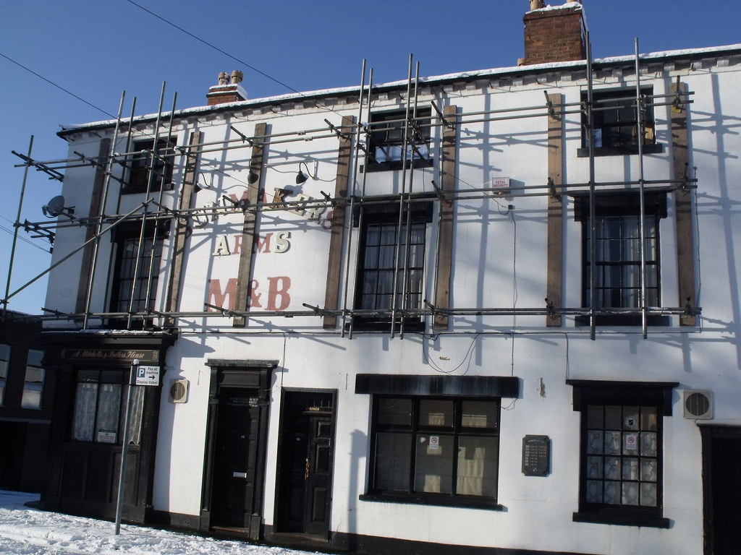
Overhead powerlines
The possibility of electrocution is very real.
Non-fatal contact usually results in loss of limbs!
This Photo by Unknown Author is licensed under CC BY
Notes:
The next hazard we will look at is overhead powerlines. The possibility of electrocution is very real. A competent person should assess the worksite for electrical hazards for any scaffold use. A 10’ minimum must be maintained between scaffold and electrical hazards or the line must be de-energized or properly insulated by the power company before work begins. Even non-fatal contact can result in loss of limbs.

Slide 10
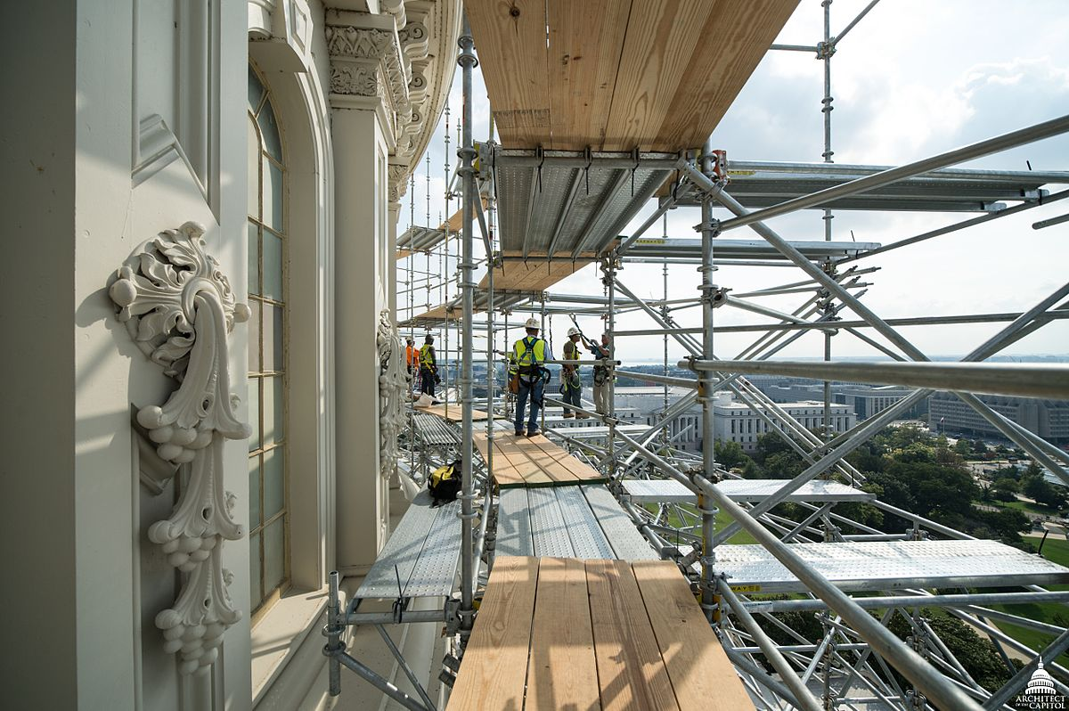
Safe scaffold construction
Have a competent person onsite
Use proper scaffold construction method
Provide proper access
This Photo by Unknown Author is licensed under CC BY-SA
Notes:
Next we will look at key points for safe scaffold construction;
In order to safety construct scaffolding a competent person should be onsite to assess the areas foundation, weight requirements, distance from the work required and tie in points just to name a few
The proper construction methods must be followed which we will dig a little deeper into and must also be organized by a competent person
Additionally thought should be given to providing a proper access point to the scaffold to prevent workers using an alternate way which may create a fall or collapse hazard

Slide 11
Safe scaffold construction
Platforms must:
Be fully planked or decked
Be able to support its weight and 4 times the max load
Be at least 18 inches wide
Ends must extend over support 6 inches
Scaffold Height:
Height should be no more than four times its minimum base dimension
If it exceeds that guys, ties or braces should be used
Notes:
Platform requirements include:
That they be fully planked or decked with no more than 1 inch gaps
Be able to support the weight of the system and 4 times the maximum load
They must be at least 18 inches wide and
Each end of a platform, unless cleated or otherwise restrained by hooks, must extend over its support by at least 6 inches
In regard to scaffold height; the structure should be no more than four times its minimum base dimension unless guys, ties, or braces are used

Slide 12
Safe scaffold construction
Scaffold Access:
No climbing cross braces
When using a ladder, bottom rung no more than 24 in high
Supervision:
Scaffolds can only be erected, moved, dismantled or altered under the supervision of a competent person
Notes:
To continue... There are specific requirements around access and supervision as well
It is important that all workers are aware of the appropriate access points and are instructed not to climb cross bracing as this could damage or compromise the structure.
When using ladders, the bottom rung should be no more than 24 inches high. Some end frames are designed to be climbed and others are not.
In relation to supervision, as stated before, all activity such as scaffold erecting, moving, dismantling, or altering should be done under the supervision of a competent person

Slide 13
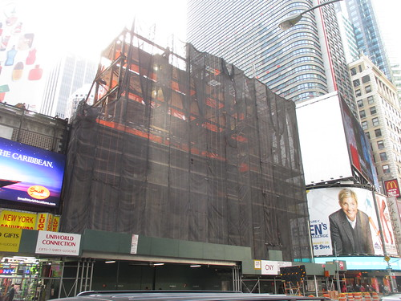
Weather conditions
Don’t work on snow or ice covered platforms or during storms or high winds
This Photo by Unknown Author is licensed under CC BY-NC-ND
Notes:
Weather conditions must be taken into consideration when working from scaffolding as well.
It is critical that work is stopped any time there is snow or ice covering platforms or during storms or high winds.
Scaffold coverings can help with this however special wind load considerations must then be factored in as well.

Slide 14
Scaffold Hazard Review
Falls from elevation
Bad planking
Scaffold collapse
Getting struck by
falling tools or debris
Electrocution
Notes:
To conclude lets review the primary hazards that we covered.
Falls from elevation
Bad planking
Scaffold collapse
Being struck by tools or debris and;
Electrocution
Scaffolding can be a critical piece to your job. They can provide efficiency, safety, and allow easier access to the work area. However, managed and constructed improperly, they can have devastating affects. Putting the time and effort into training employees as well as designating a competent person to assess hazards, plan, and execute the construction and dismantling of scaffolding can save lives.

Slide 15
For more information on scaffolding and compliance you can go to the OSHA website at osha.gov and by using the direct links below:
29 CFR 1926 Subpart L
29 CFR 1910.27 Scaffolds and Rope Decent Systems
OSHA Safety and Health Topics - Scaffolding
OSHA Scaffolding eTool
29 CFR 1926 Subpart L
ANSI/ASSP A10.8-2011
29 CFR 1926.451 Scaffolds – General Requirements
Notes:
For more information on scaffolding and compliance you can go to the OSHA website at osha.gov and by using the direct links below:

Slide 16
Questions?
Contact Us: 405-962-3750 or 405-230-0216
Notes:
I hope that you have found the information presented today to be useful. We welcome the opportunity to further assist you with developing your safety policies and procedures. Be sure to visit our website at www.compsourcemutual.com for more information on fall protection. If you have any further questions you may contact us at CompSource Mutual at the numbers provided on the screen. Have a great day!

